Slide 1
The American Dream
By: Robinson Chen

Slide 2
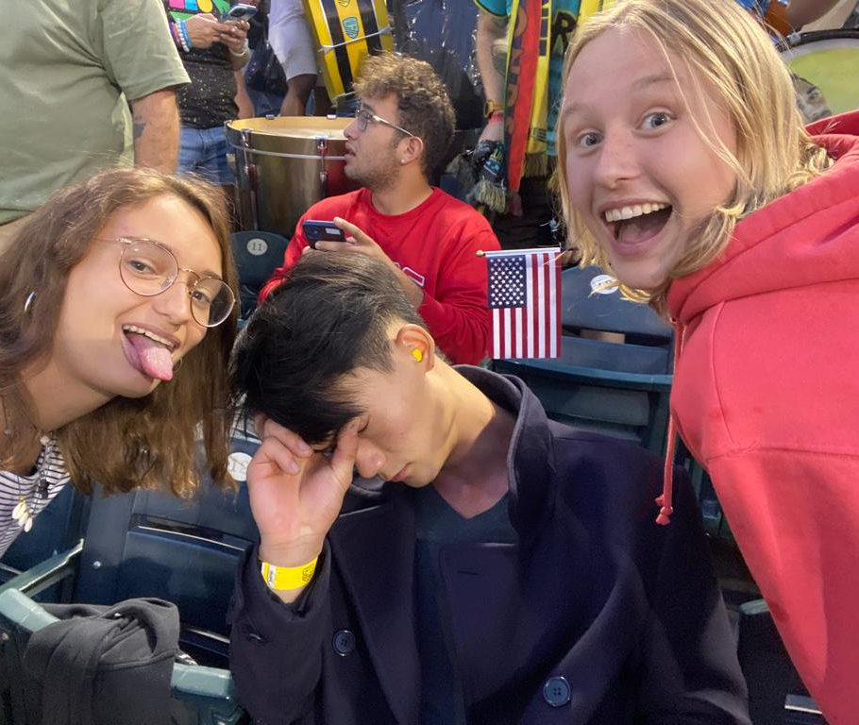
A time Well Spent
It’s always a blast to spend time with those you love. Here I made many friends. And I definitely loved spending every second with them

Slide 3
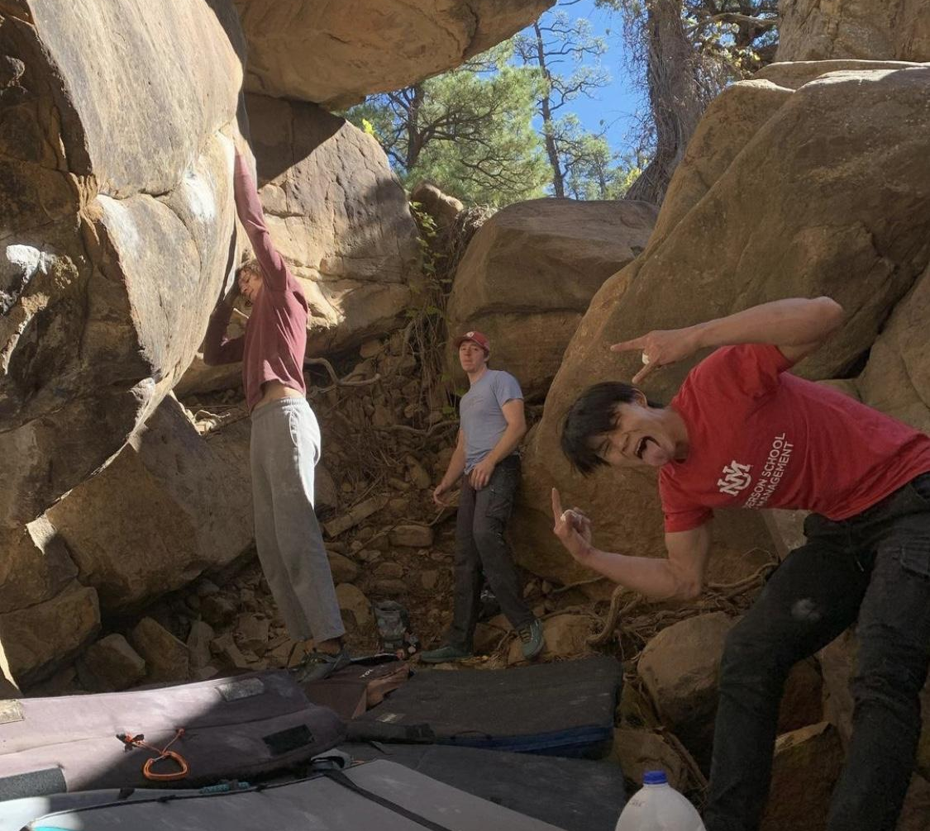
Exploration is the mother of discovery
I originally thought this barren desert was going to be a little like home, not very eventful. My believes where wrong as every corner I would turn would be filled with wonderment and amazement. New things everywhere.

Slide 4
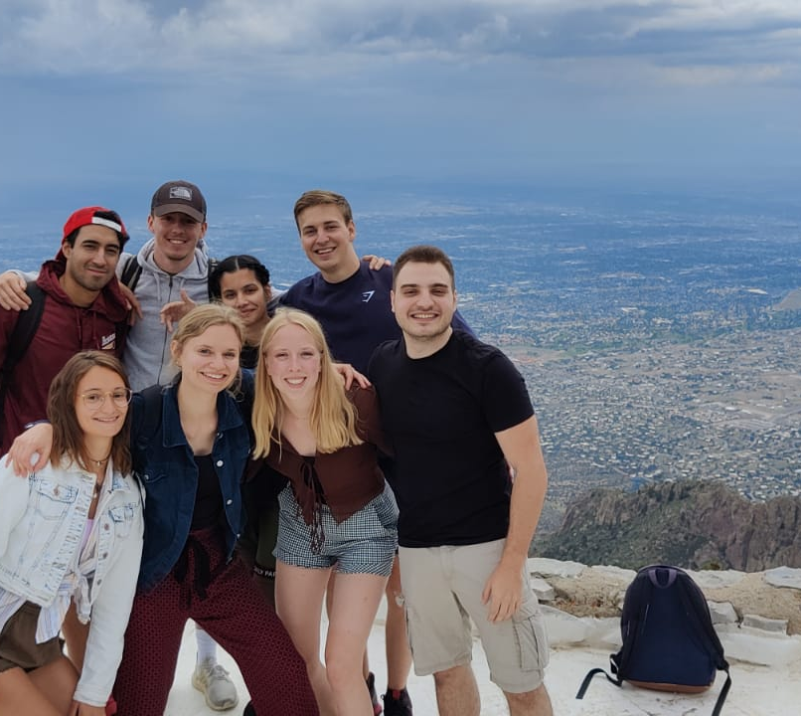
Atop the heights mountains
I loved hiking my way through new mexico, still much to be explored but the time spent with friends going up this amazing cliffs were amazing.

Slide 5
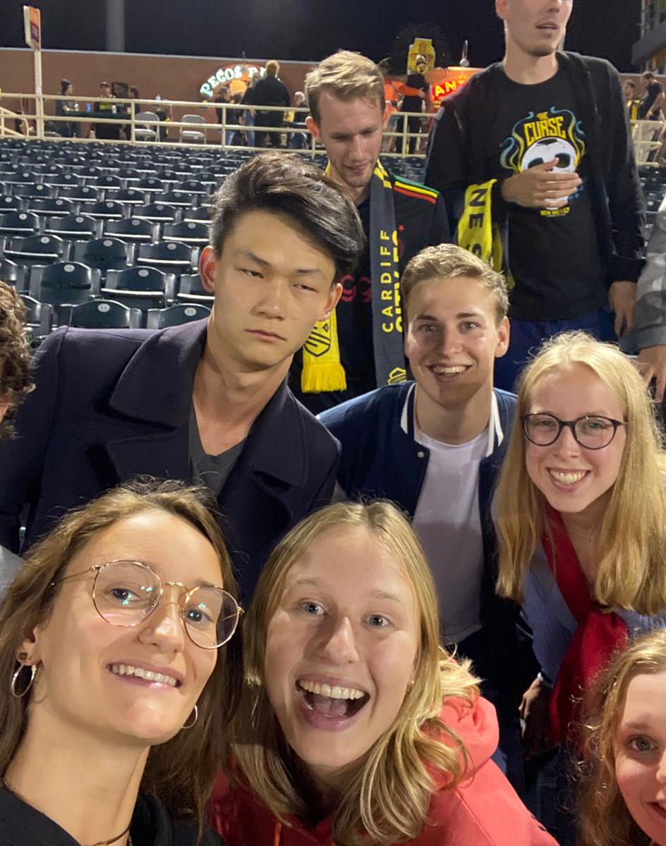
Random but fun
One of my highlights, the first week actually, was when I was talking to a stranger in a parking lot with my newly made friends that day and we befriended him so much that he decided to give us free tickets to a baseball game.

Slide 6
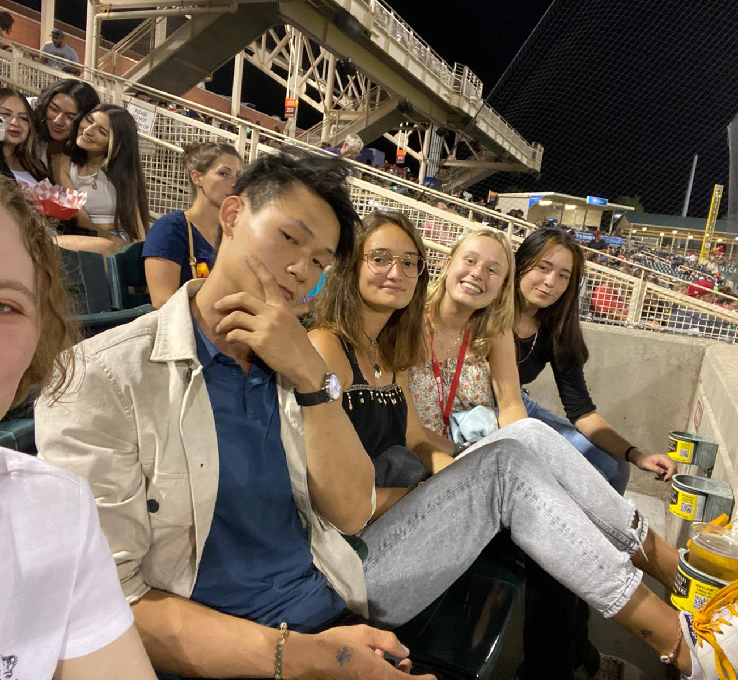
Friends Galore
What a time to meet people. Here everyone is friendly, it’s hard to make friends but meeting people is always fun.

Slide 7
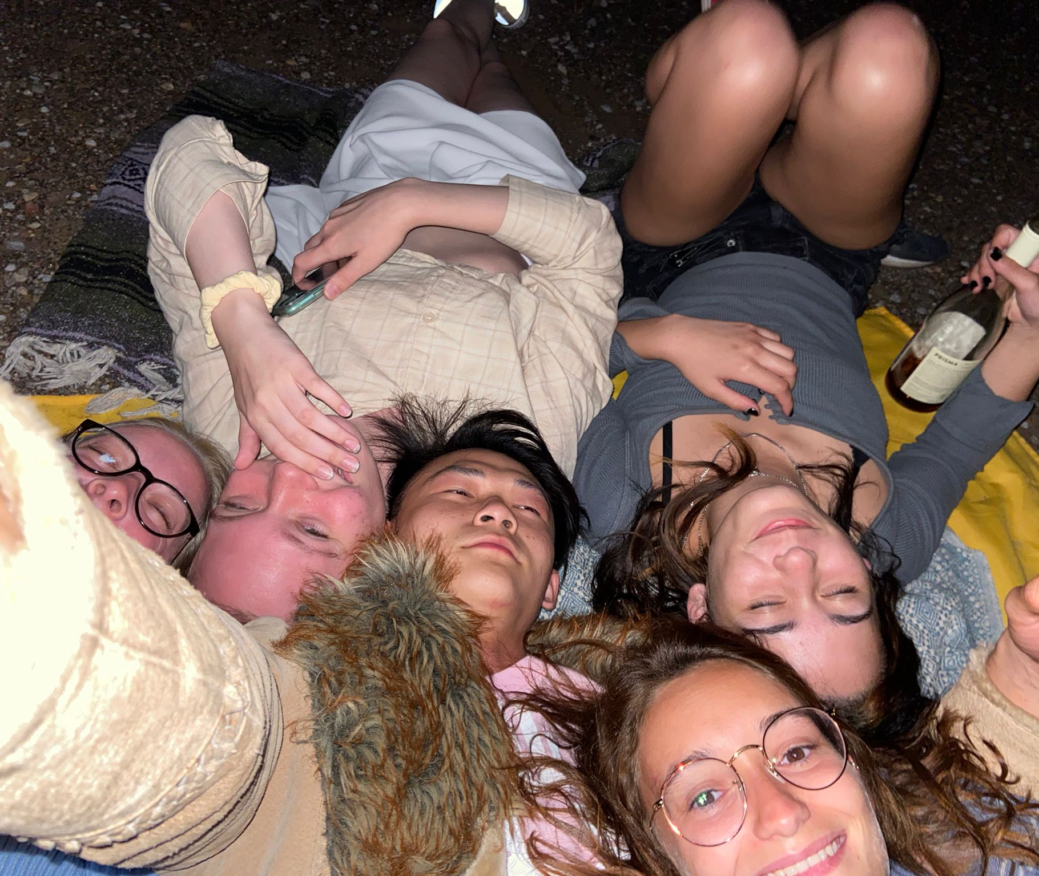
The nights
Adventures are always the thing that I seek to do, random escapades into the night ot stargaze, to backpacking trips to the highest peaks in the frozen forests.

Slide 8
Making Habits
My love of rock climbing will always transcend wherever I go. In New Mexico I made it a habit to climbing everyday I could, and I loved every second of it!

Slide 9
New Experiences
I am always someone who love to explore new things. This was the prime time to do all the things that are offered: here I am horseback riding!

Slide 10
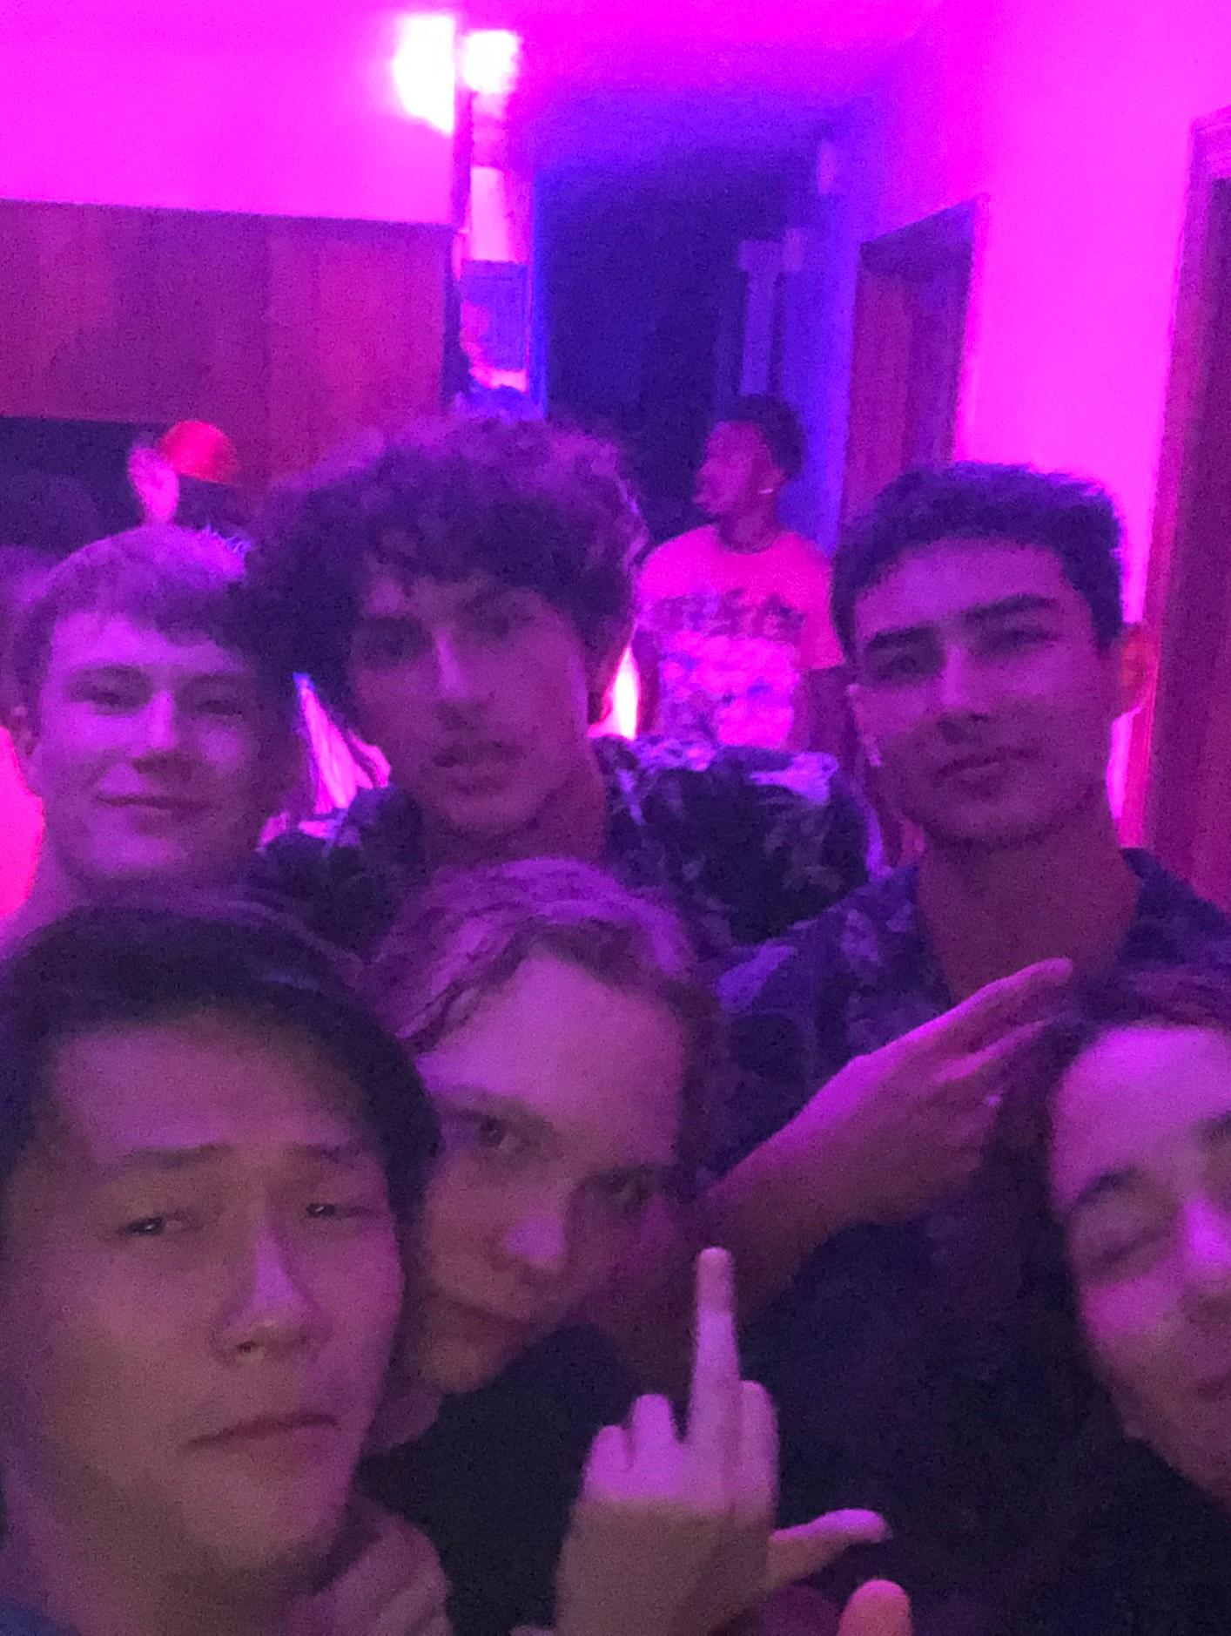
Parties and The Rockstar Life
In New Mexico, going out was a big part of what I did, I would often work hard during the weekdays to have the time to go out. The nights would stretch out to 4 am sometimes, and it was all part of the human experience, an amazing one I might add.

Slide 11
Friends of a lifetime
Some of the friends I made I consider family, and hopefully I will get to visit them soon. This is important to me, to make new friends and make connections. In the future I might be able to use them to further my career.

Slide 12
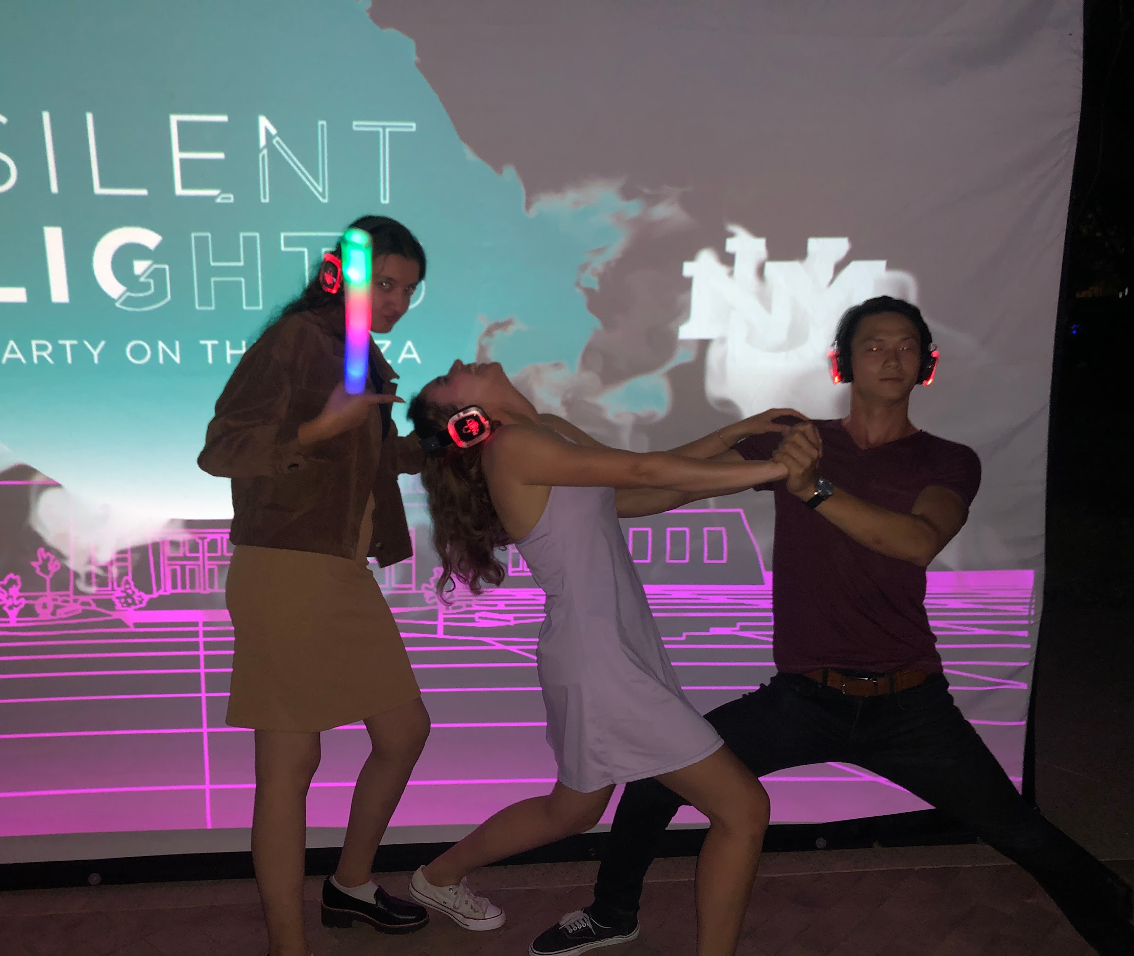
The Dance of life
Life is always full of adventures, and I loved dancing my way through it, literally and figuratively. Here I am dancing with my friend in a silent disco night.

Slide 13
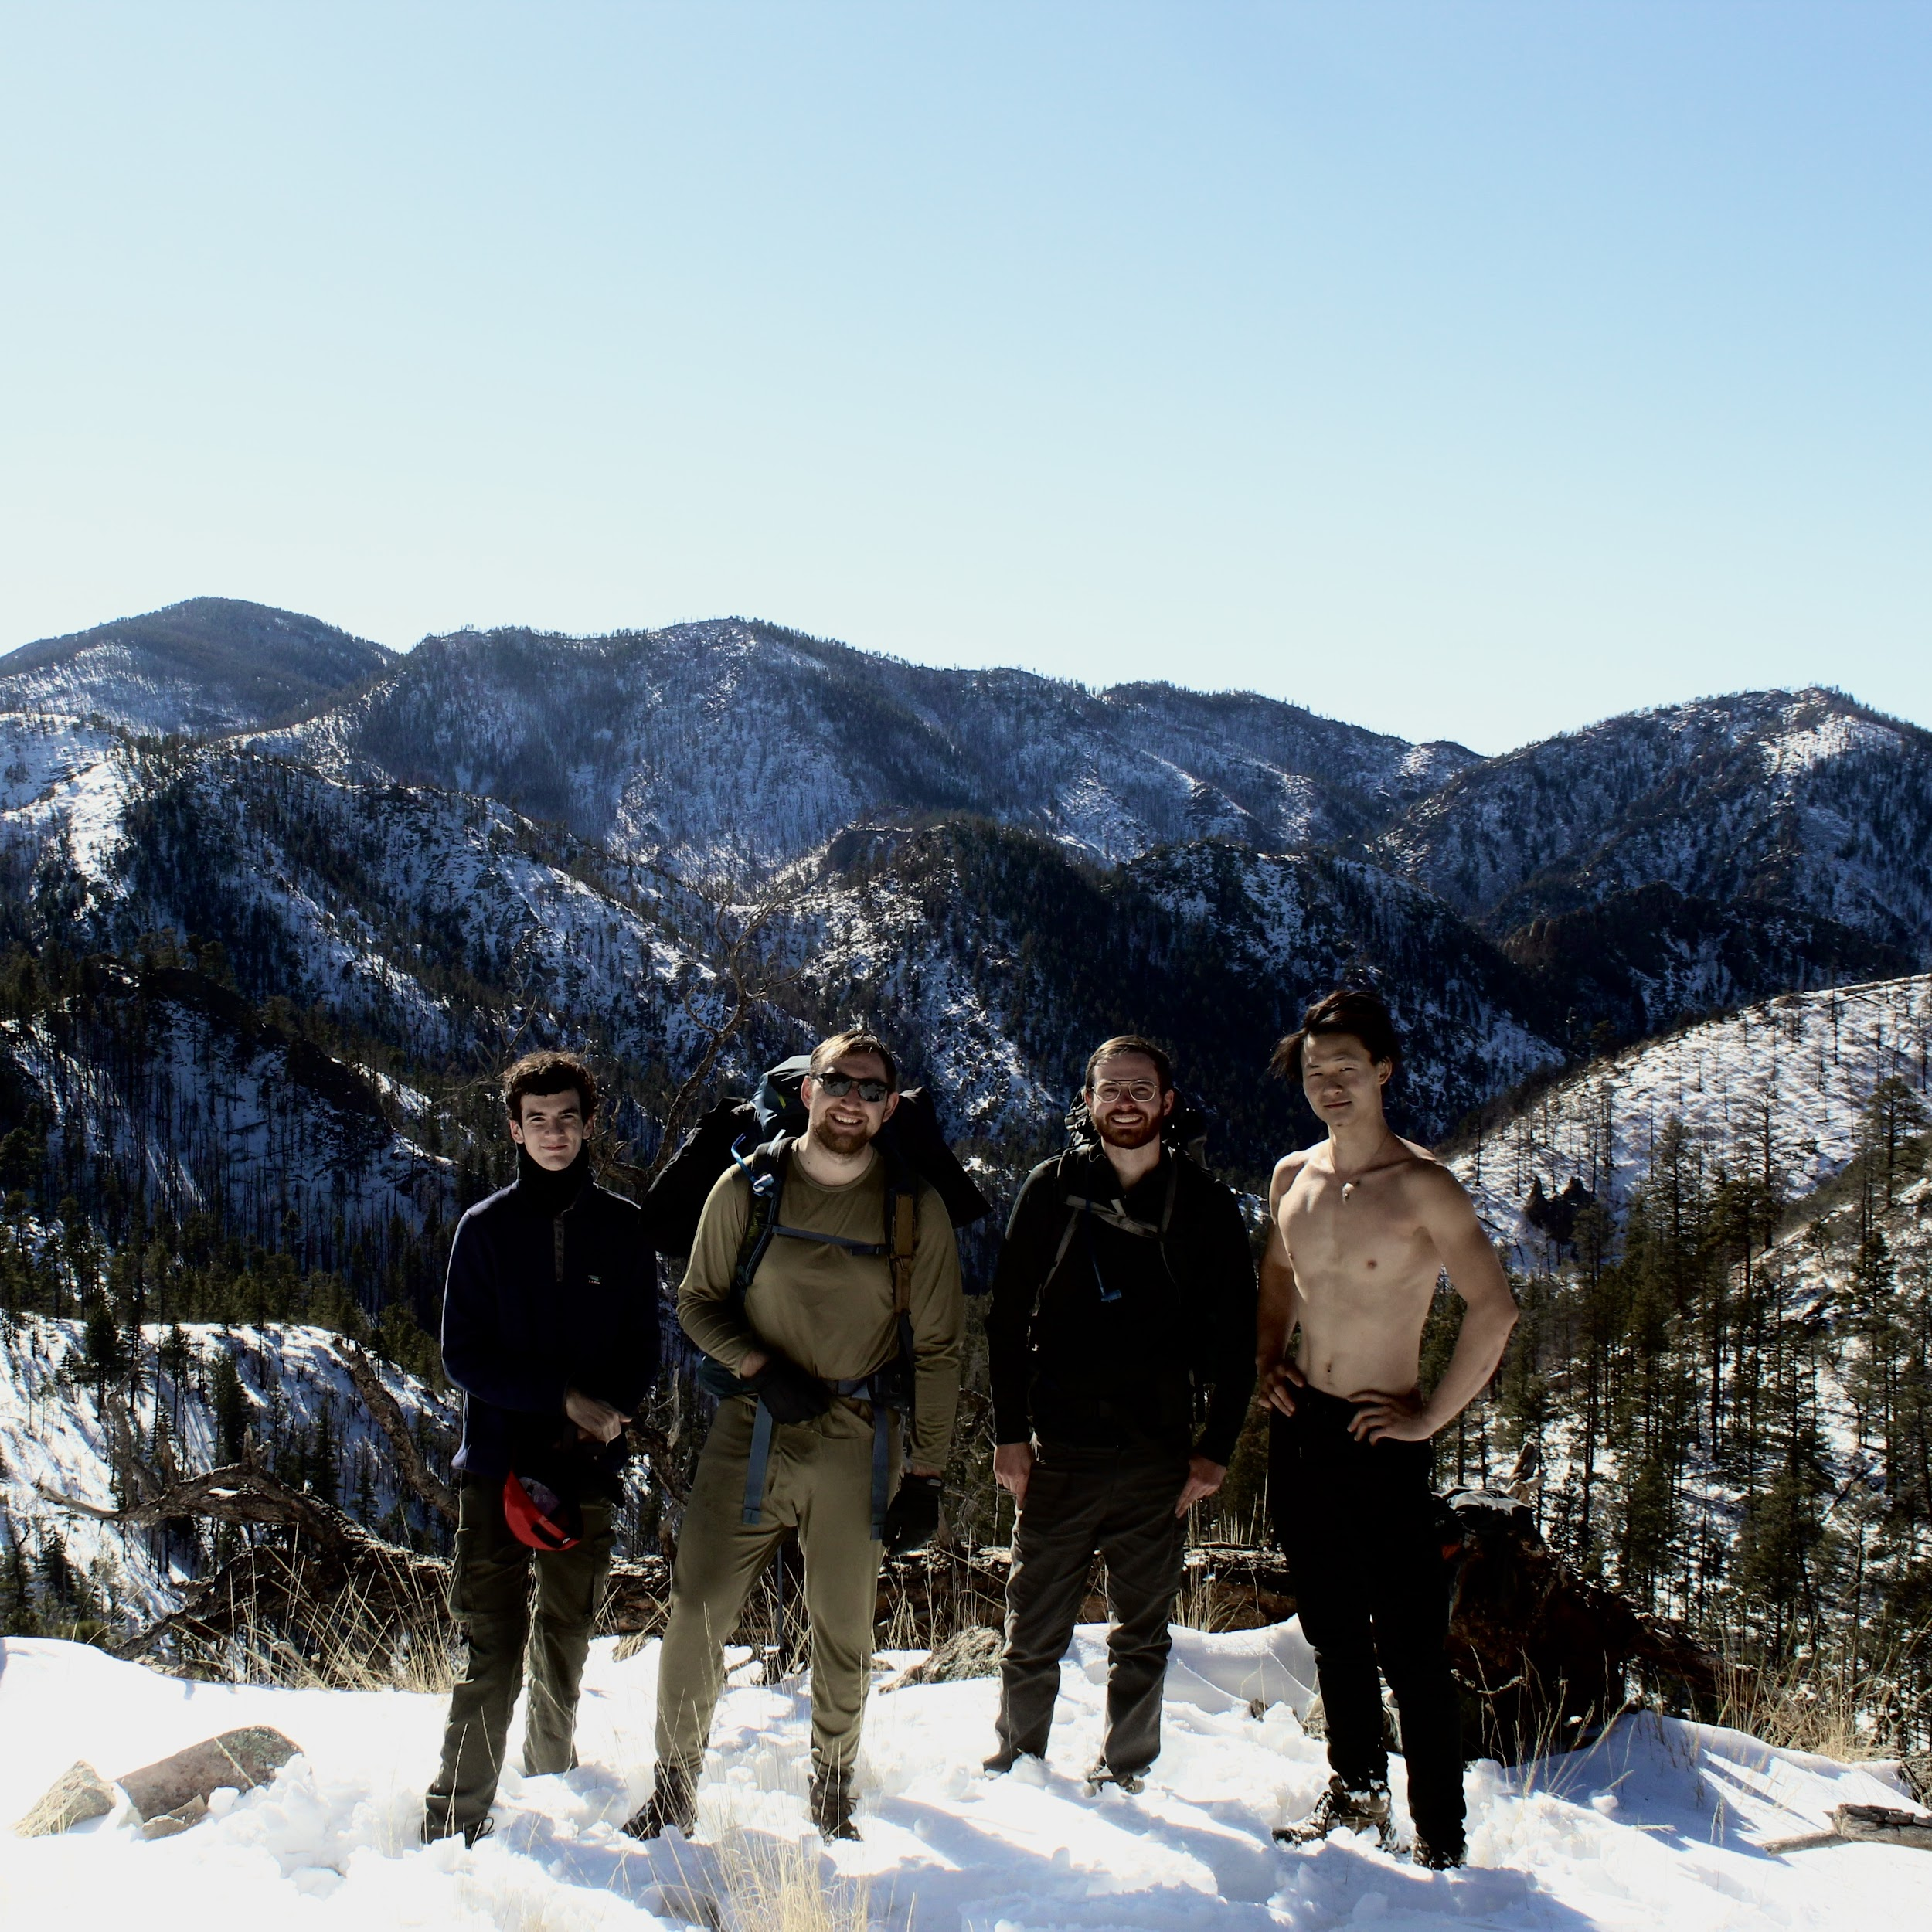
Oh the Beauty
New mexico is full of amazing nature, beautiful mountains, trees foxed. It is really a sight to behold.

Slide 14
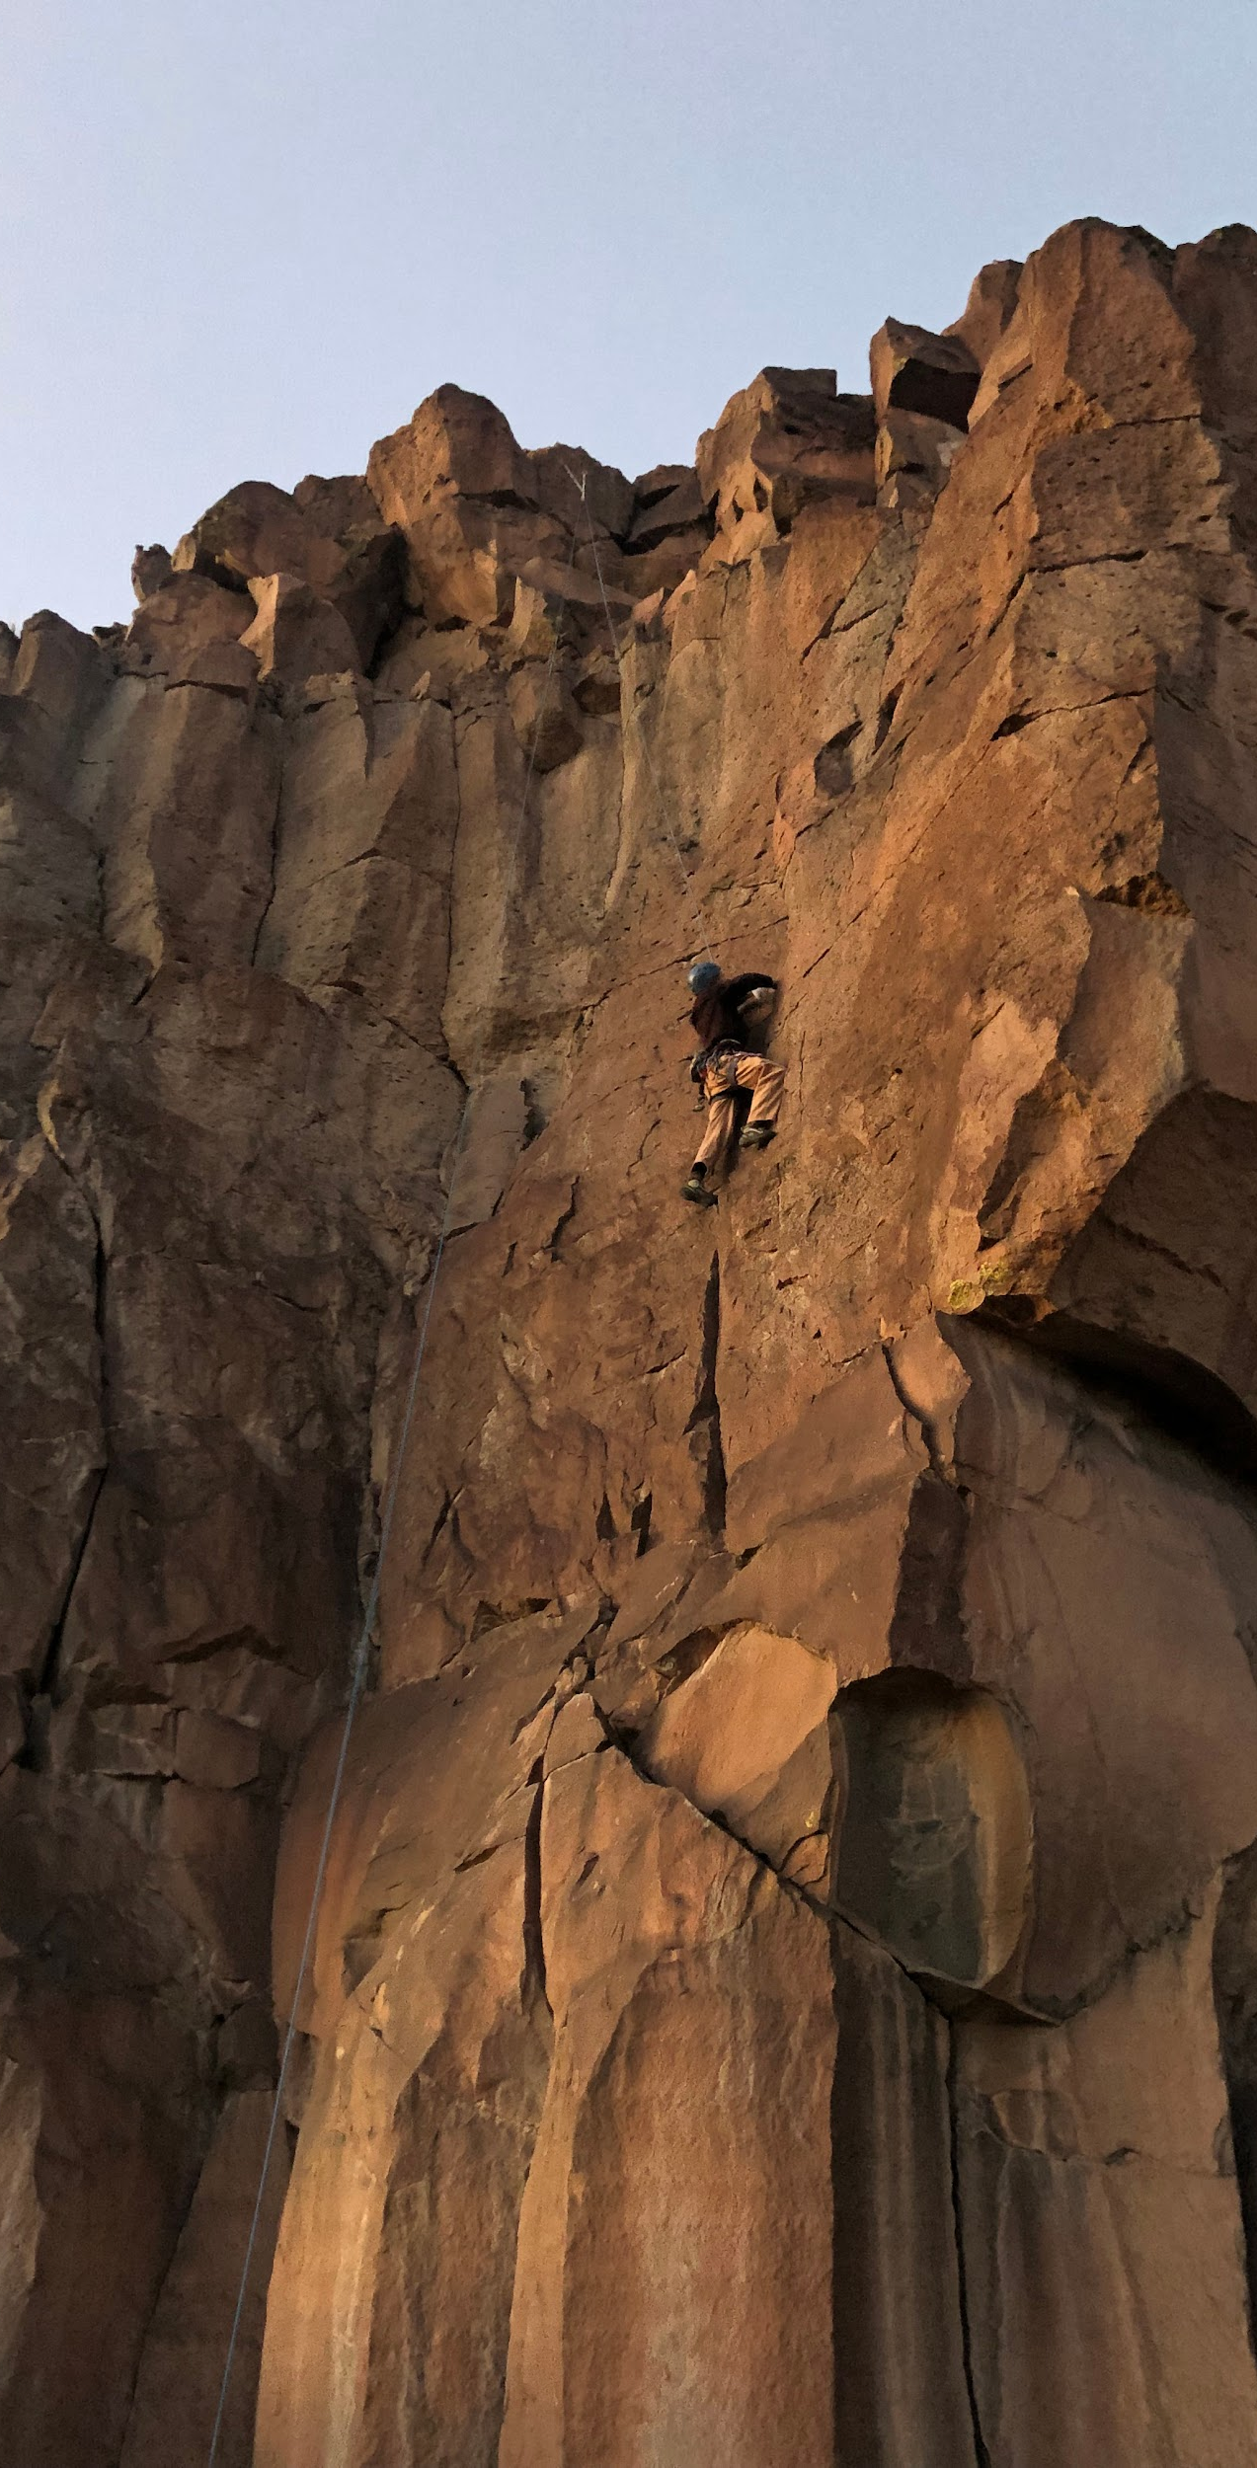
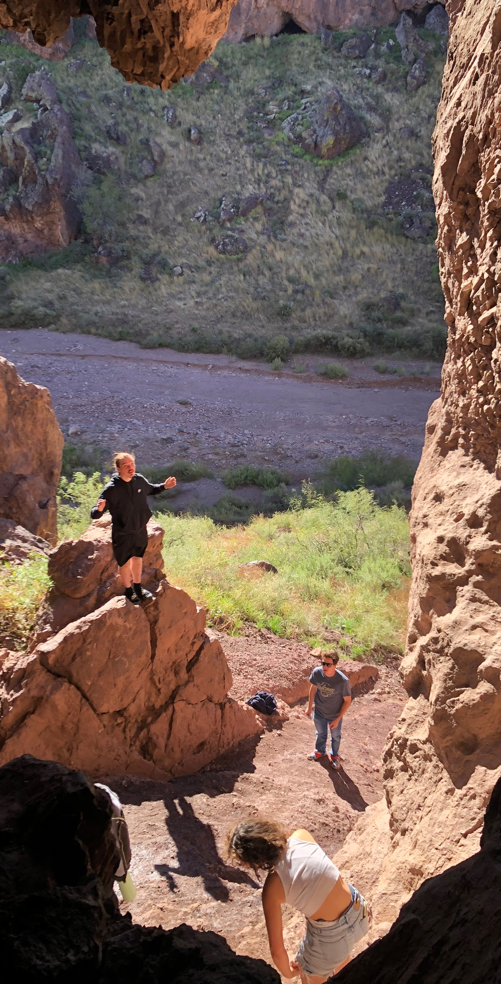
Exploration is the mother of discovery
I originally thought this barren desert was going to be a little like home, not very eventful. My believes where wrong as every corner I would turn would be filled with wonderment and amazement. New things everywhere.

Slide 15
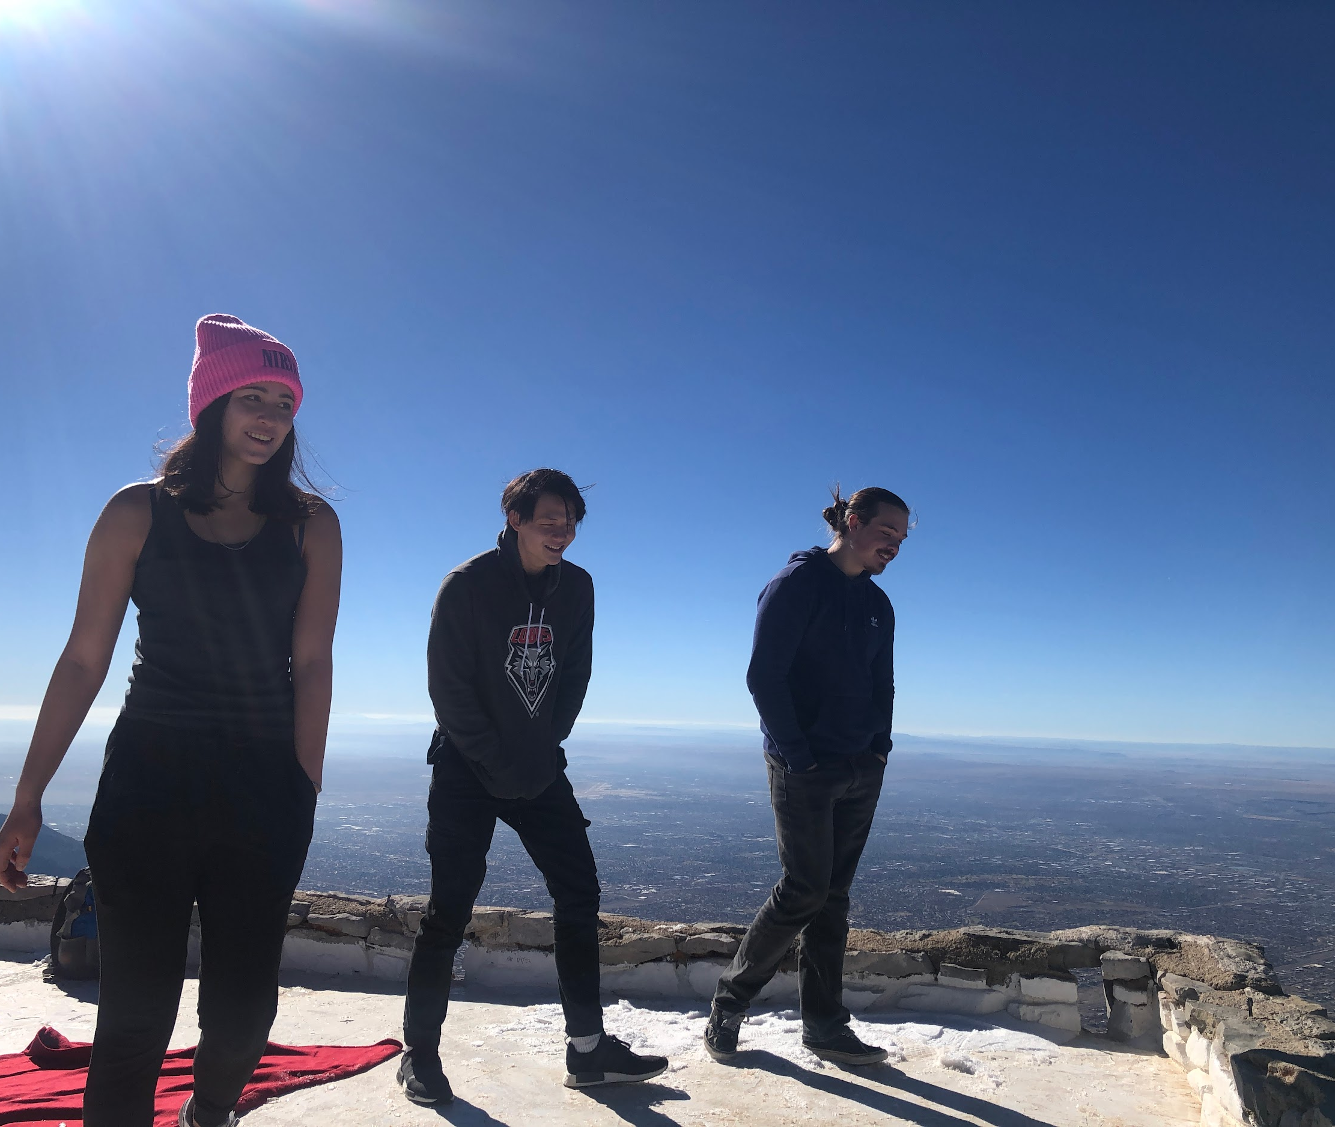
Friends till the end
Life is full of ups and downs, people come and go all the time. They make us who we are and they mold the path that we will take. Thanks to these connections in life, the ones that add the beauty in it, we grow.

Slide 16
New Mexico:
“The land of Enchantment”

Slide 17
Thank You

